Slide 1
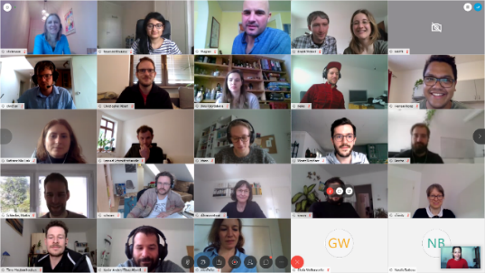
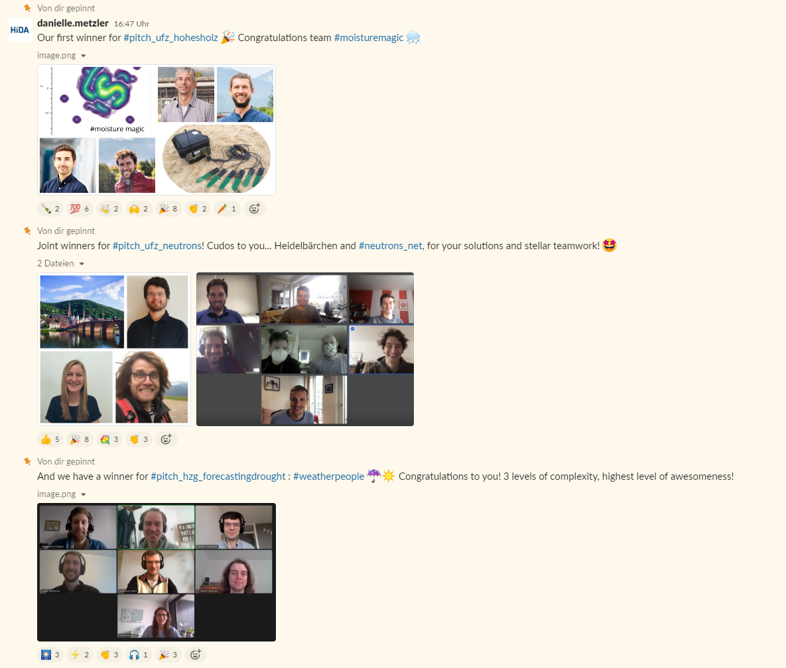
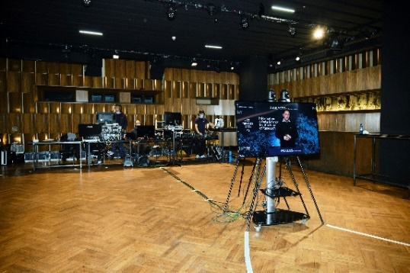
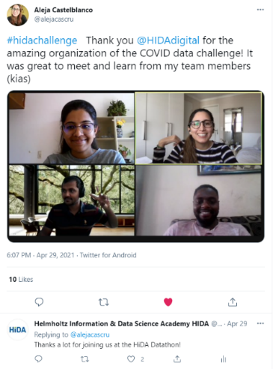
Challenges & Hackathons
… with HIDA as partner
Remote challenge on Climate Change, April 2020
Good experience in planning and executing challenges and hackathons online-only and online-first:
High international participation rate up to 45%
Quickly reach desired number of participants through advertising, for online events low bounce rate around 20%.
High satisfaction of participants
Exciting national and international partners: KIT, Forschungszentrum Jülich, Deloitte, NVIDIA, Umweltbundesamt, ...
Helmholtz Data Challenges Platform
Datathon for Climate Change, Nov 2020
International Covid-Data Challenge, April 2021
Data Challenge:
Help a Hematolgist out, September 2022

Slide 2
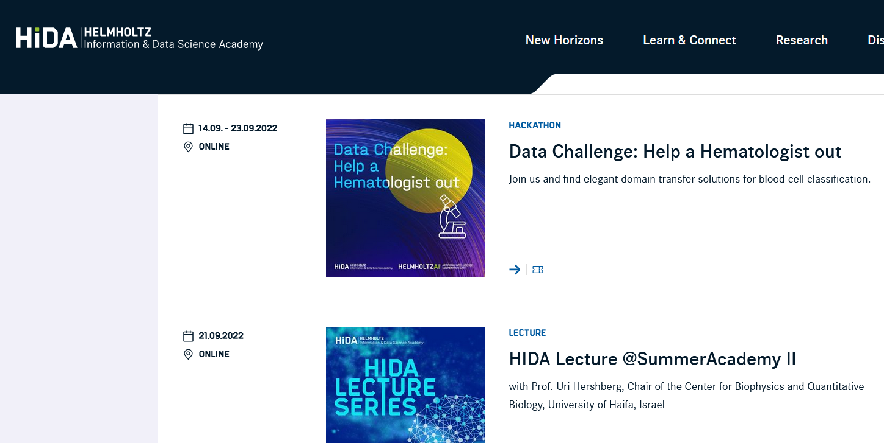
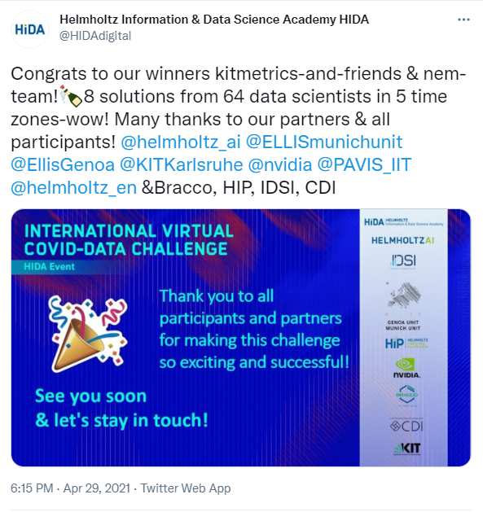
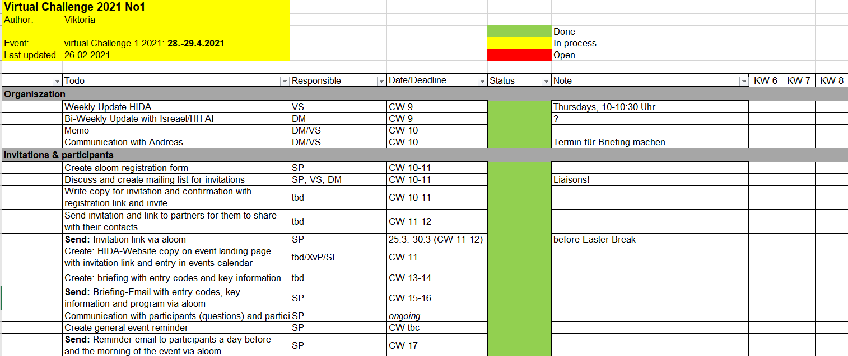
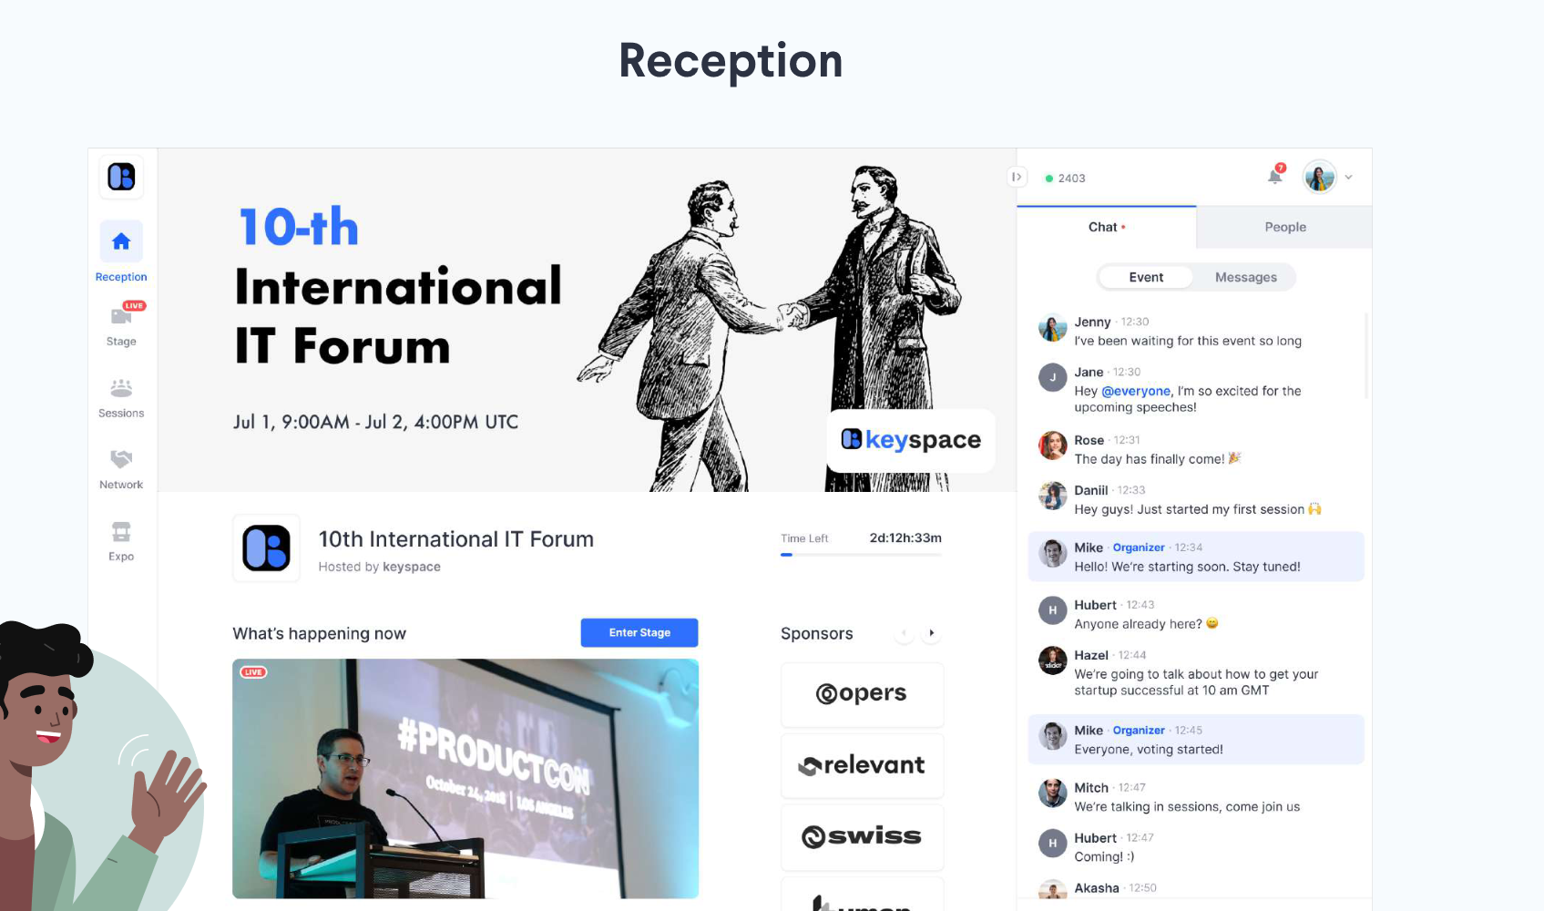
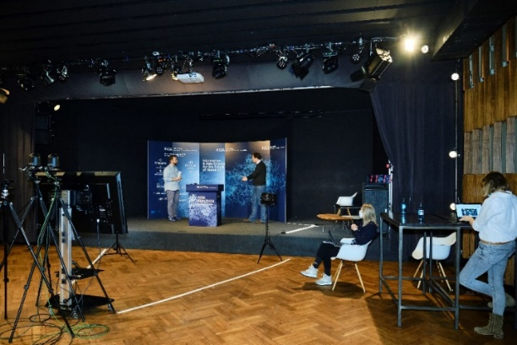
Challenges & Hackathons
…what HIDA can do for you
Advertising
Announcement and communication support: Social Media (Twitter 2758 followers, LinkedIn 804 followers)
Consulting
Consulting for project planning
Implementation: live & digital
Consulting in the search for a suitable on-site location and implementation planning according to hygiene guidelines in Berlin
Event and news post on HIDA website
Newsletter with 600 subscribers interested in data science
HIDA Give-Aways
Advice on scheduling for virtual & presence/live events
Contacts to further partners i.e. Helmholtz AI
German and English speaking moderation
Consulting in the search for suitable additional service providers (catering, technical companies, etc.)
Digital implementation with the event management tool Hopin/Slack with HIDA

Slide 3
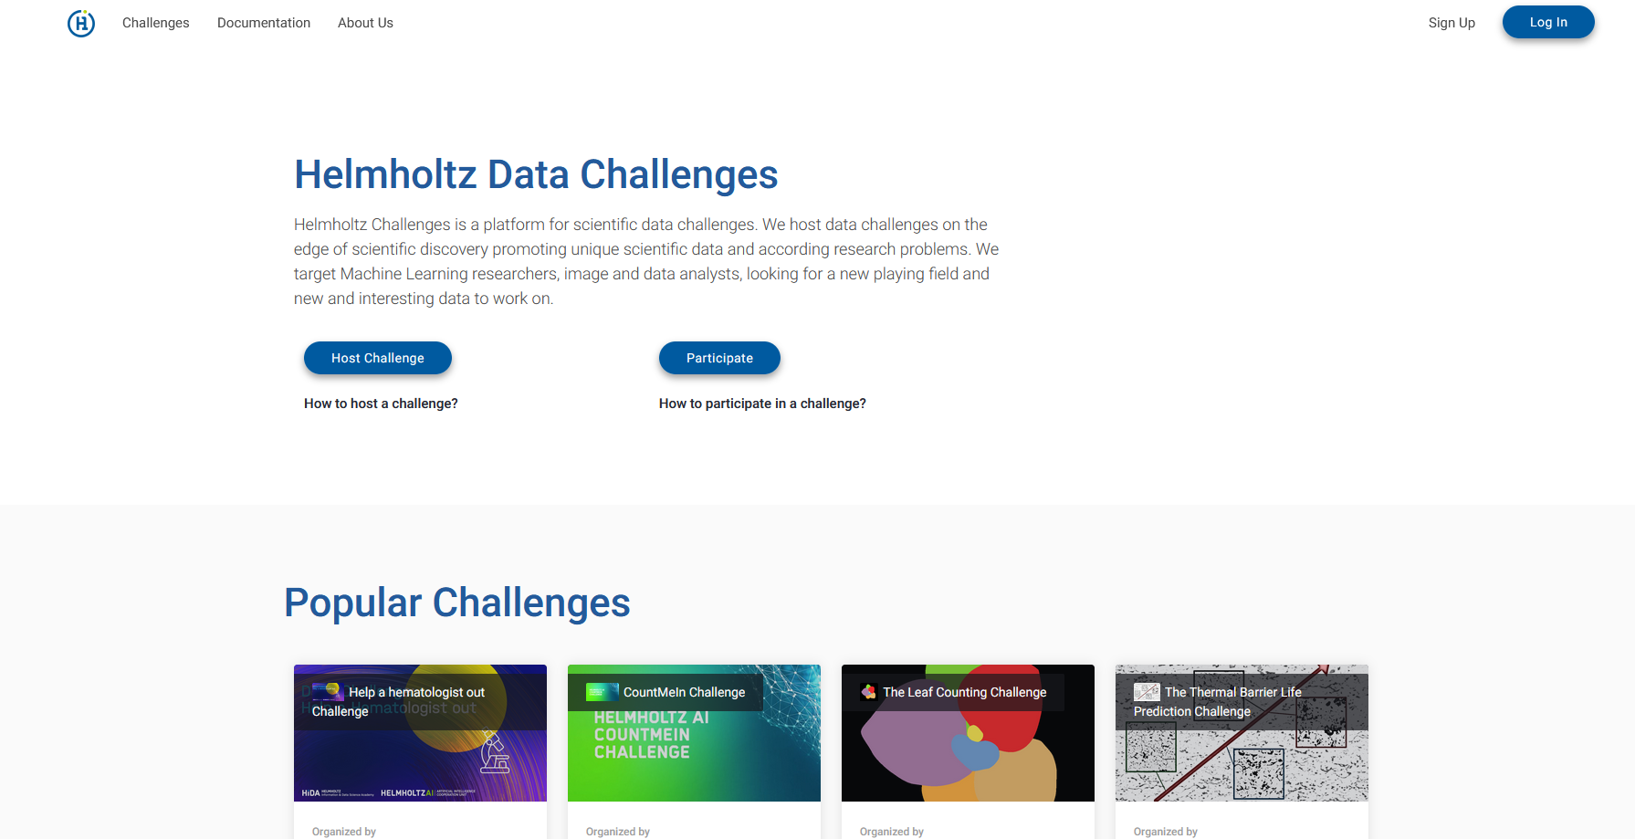
Challenges & Hackathons
… Helmholtz Data Challenges Platform

Slide 4
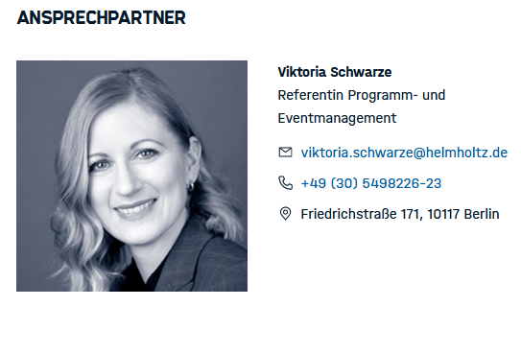
Challenges & Hackathons
… What HIDA would like to have as a partner
Not much ☺
HIDA as partner logo on communication materials (website, social media, etc.)
Mention HIDA in the program as a partner, preferably brief introduction by HIDA in the program.
Contact us, we are looking forward
to work with you!

